Slide 1
CAREER TRAJECTORIES DATASET ANALYSIS SALARY & EXPERIENCE ACROSS GLOBAL INDUSTRIES
PRESENTED BY
VEENA SRI PM
DATA SCIENCE AND DATA ANALYTICS
RP 33

Slide 2
OBJECTIVE
To perform a Data-Driven Analysis on Career Trajectories-Salary trends across Industries
To study the impact of Salaries - Experience, Education, Gender and Location
GOALS
Salary distributions across Industries, Job Titles, Experience
Gender-based salary disparities
Relation between Education and Salary
Country wise Salary differences

Slide 3
DATASET DESCRIPTION
Records-28104 in count
Age Range, Gender, Location
Industry, Job Title, Experience
Salary, Additional Monetary Compensation
Overall and field experience mentioned
Highest Education pursued
DATA CLEANING
Standardized Handling Missing Values, inconsistency and Outliers, Formatting
Converting all currencies to USD
LOOKUP Function and Formula are implied

Slide 4
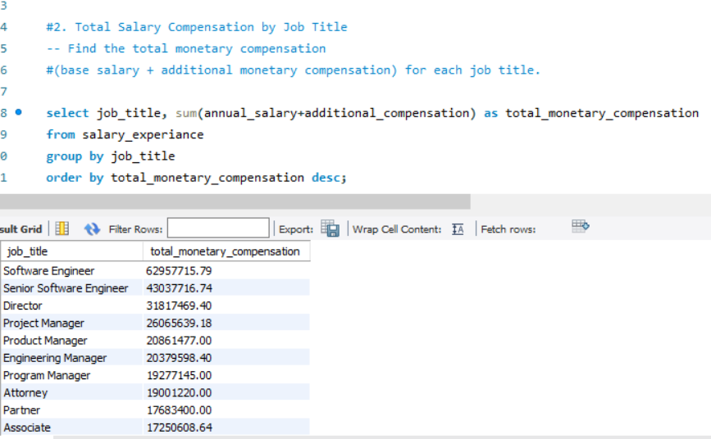
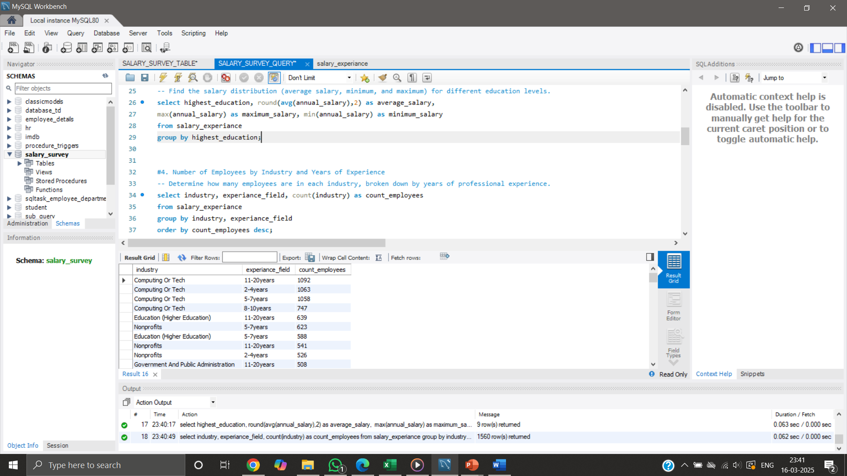
MYSQL - IMPORT AND QUERIES
Database and Table structure created
Cleaned Dataset imported –MYSQL workbench
Using Table Data Import Wizard Dataset is imported
Annual salary respect to influencing factors are predicted using queries

Slide 5
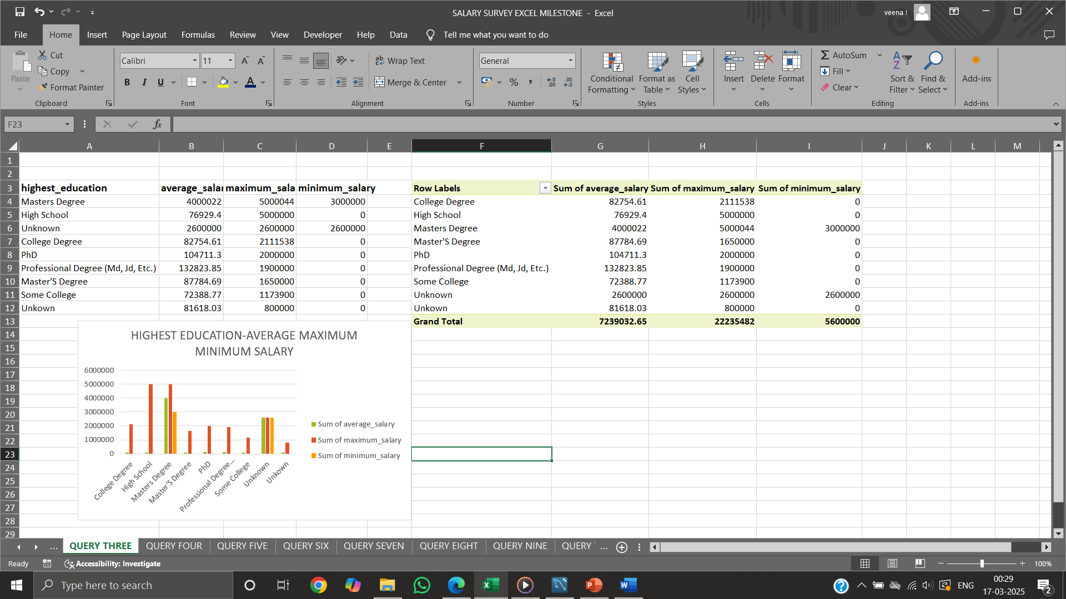
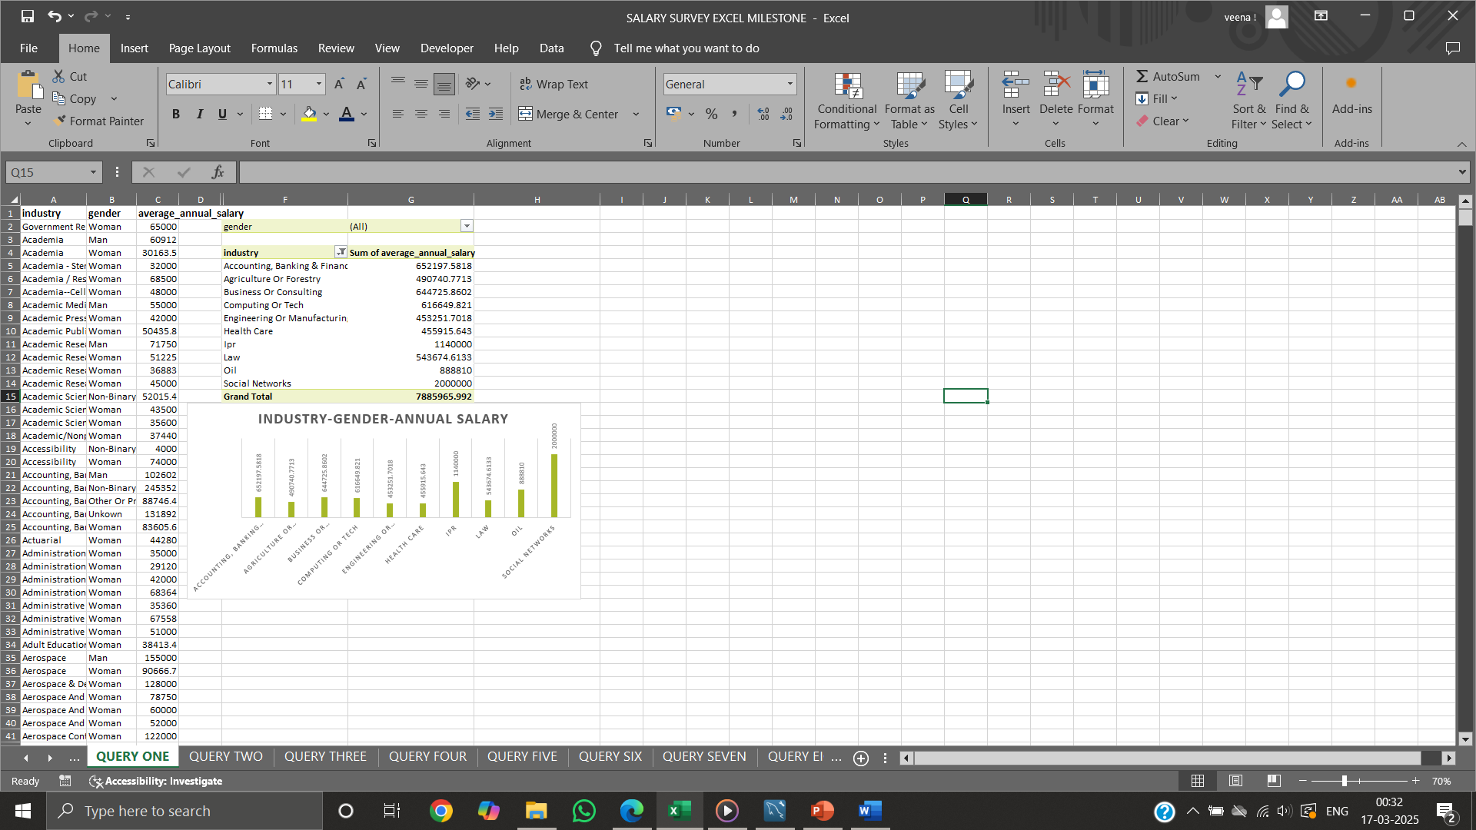
RESULT EXPORT AND PIVOT TABLE
EXPORT - option in result grid exports result in ‘.csv’ format
Pivot Table- A Data analysis tool that summarizes large Data

Slide 6
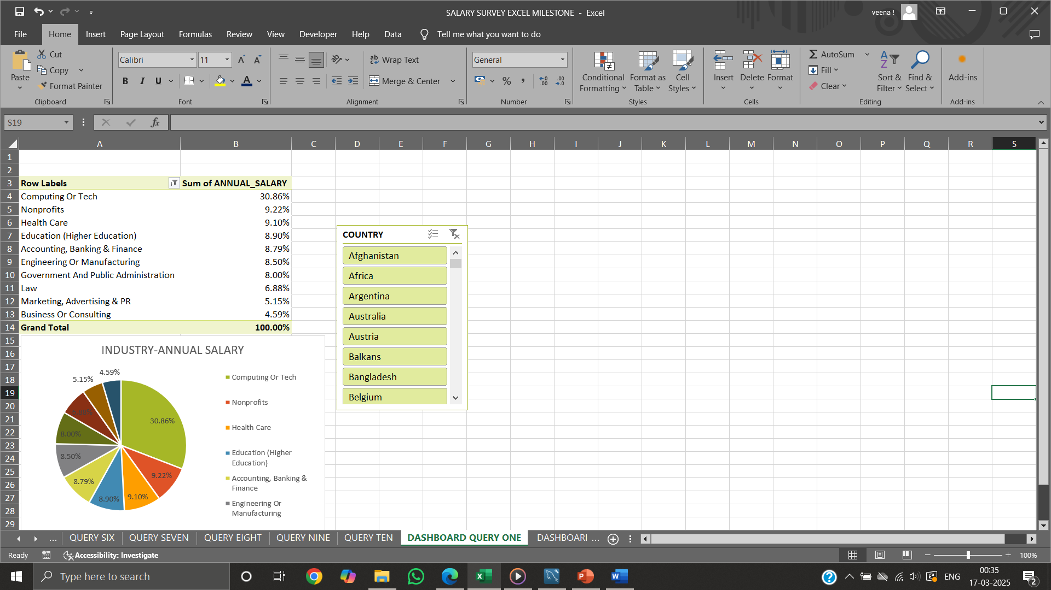
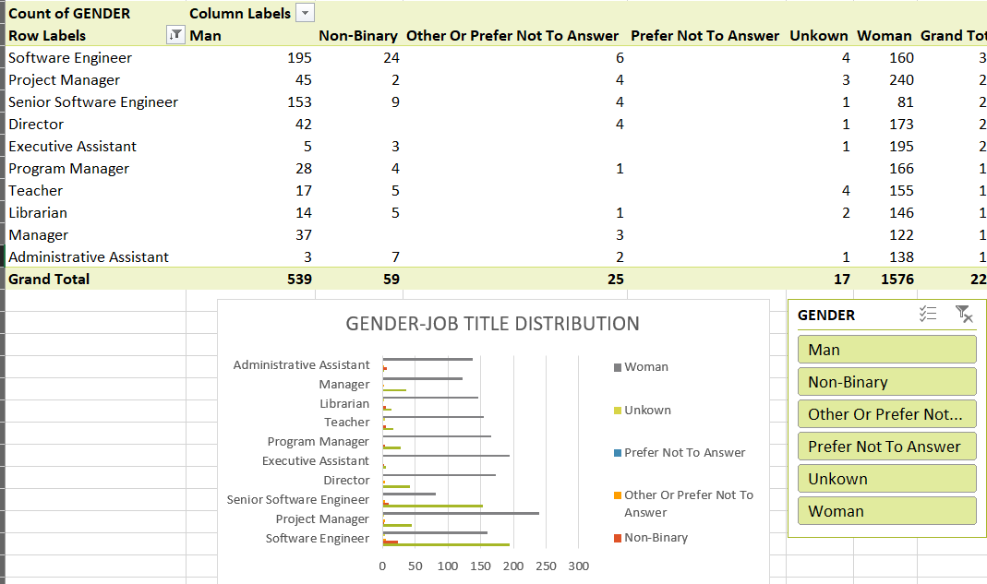
DASHBOARD ANALYSIS
Salary distribution by Industry
Gender distribution across different Job Titles
Top-paying job titles

Slide 7
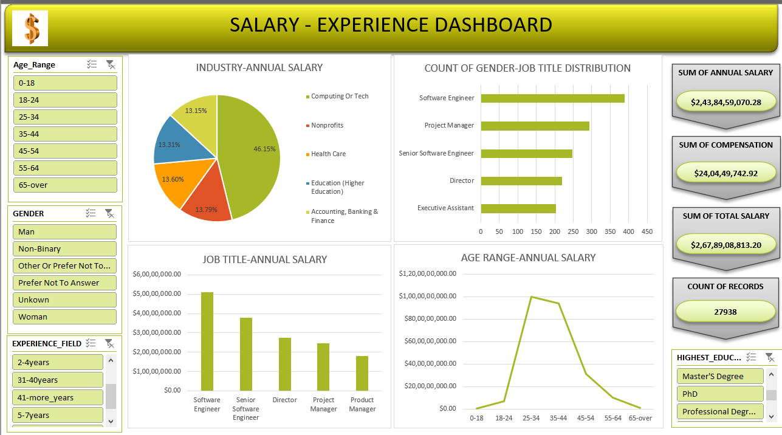

Slide 8
INSIGHTS
Professionals over 10 years of experience tend to earn significantly higher salaries
Master's and PhD, correlate with higher salaries
Tech & Finance offer the highest salaries
Men earn more on average, even in female-dominated industries
Developing countries see much lower pay for similar jobs
Women over 40 move out from their carrier
Age over 66, prefer convenient job – Social Networks

Slide 9
CONCLUSION
For career progression, combination of education and experience is ideal
Salaries influenced by Industry, Experience, Education
Gender disparities & Location salary variations are evident
RECOMMENDATIONS
Promote upskilling and Education
Providing flexibility for women employees
Conducting studies on salary negotiations

Slide 10

QUESTIONS

